Slide 1
Logic Gates

Slide 2
Logic Gates
We have looked at Boolean functions in abstract terms.
In this section, we see that Boolean functions are implemented in digital computer circuits called gates.
A gate is an electronic device that produces a result based on one or more input values.
  In reality, gates consist of one to six transistors, but digital designers think of them as a single unit.
  Integrated circuits contain collections of gates suited to a particular purpose.

Slide 3
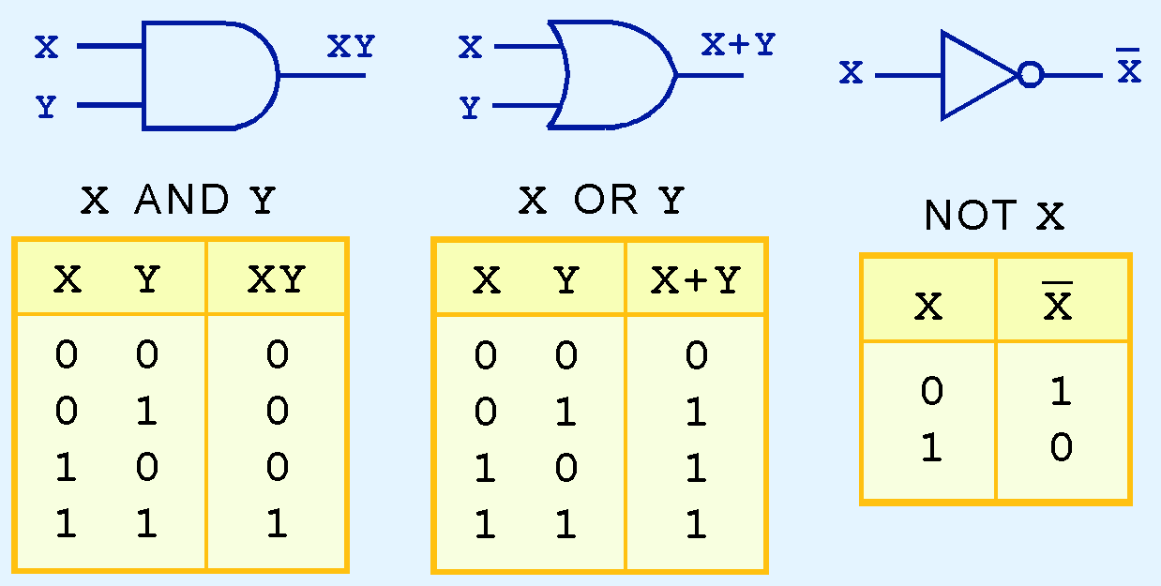
Logic Gates
The three simplest gates are the AND, OR, and NOT gates.
They correspond directly to their respective Boolean operations, as you can see by their truth tables.

Slide 4
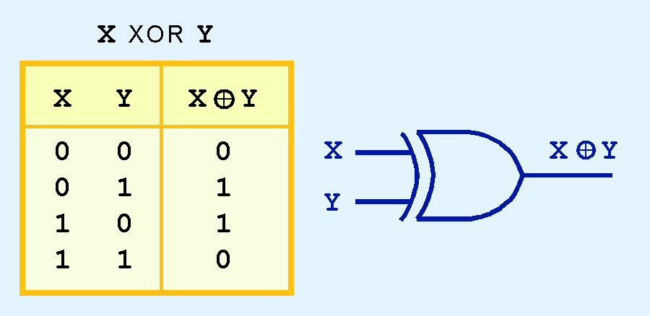
Logic Gates
Another very useful gate is the exclusive OR (XOR) gate.
The output of the XOR operation is true only when the values of the inputs differ.
Note the special symbol ⊕ for the XOR operation.

Slide 5
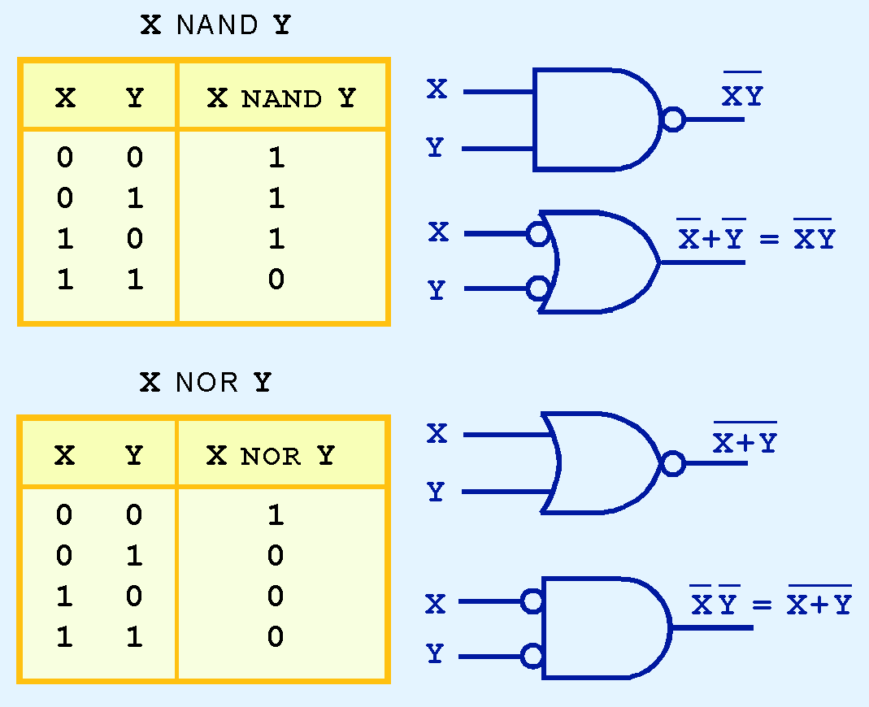
Logic Gates
NAND and NOR are two very important gates. Their symbols and truth tables are shown at the right.

Slide 6
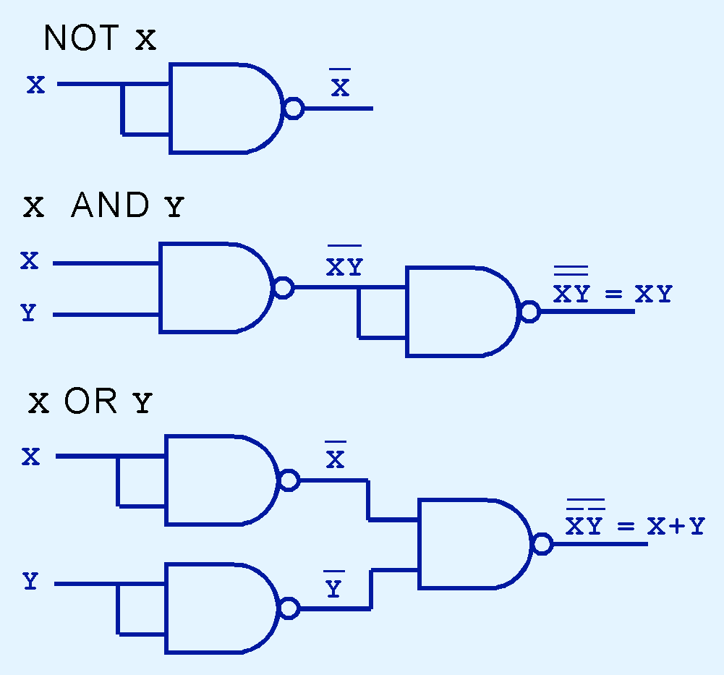
Logic Gates
NAND and NOR are known as universal gates because they are inexpensive to manufacture and any Boolean function can be constructed using only NAND or only NOR gates.

Slide 7
Q. Design a logic circuits for NOT, AND and OR gate using NOR gate?

Slide 8
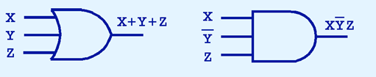
Logic Gates
Gates can have multiple inputs

Slide 9

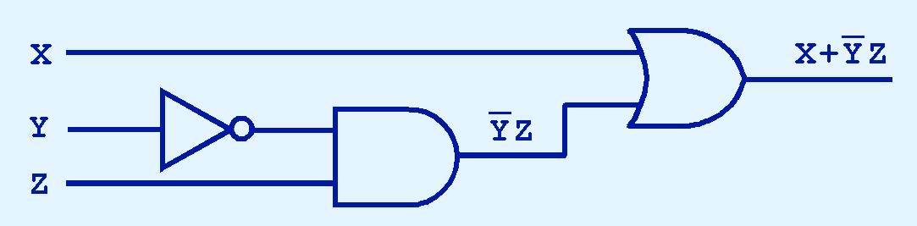
Digital Components
The main thing to remember is that combinations of gates implement Boolean functions.
Q. 2. implement the Boolean function using logic gates:
We simplify our Boolean expressions so that we can create simpler circuits.

Slide 10
Q 3. Simplify the following
X+X’Y
X(X’+Y)
X’Y’Z+X’YZ+XY’
XY+X’Z+YZ
Q 4. Find the complement of following
F= x’yz’+x’y’z
F= x(y’z’+yz)

Slide 11
Thanks

